Slide 1

Data-Driven Innovations in Commercial Spaceflight: A Python Project
Srikanth Potharla

Slide 2
Executive Summary
This project embarked on a rigorous analysis of SpaceX's launch records to predict first-stage landing successes using machine learning models. Leveraging historical launch data, we applied logistic regression, support vector machines, and k-nearest neighbors' algorithms, achieving over 80% accuracy. Through hyperparameter tuning via GridSearchCV, model performance was significantly enhanced, underscoring the potency of AutoML tools in predictive analytics. The project also illuminated patterns within the data, such as no discernible correlation between payload mass and launch outcomes and revealed the robustness of SpaceX's operations across varying payload ranges. These findings can drive future improvements in space launch strategies.

Slide 3

Commercial space travel marks a new frontier, offering private-sector-led exploration beyond Earth, pioneered by innovative companies like SpaceX and Blue Origin Virgin Galactic: Pioneering suborbital spaceflights for tourism. Rocket Lab: Specializes in launching small satellites to orbit. Blue Origin: Developing reusable rockets for suborbital and orbital flights. SpaceX: Leading with multiple space innovations, including missions to the ISS, the Starlink project, and commercial manned missions Highlight on SpaceX: Noteworthy for their cost-effective, reusable Falcon 9 rockets. A standard launch costs approximately $62 million, significantly lower than industry standards of up to $165 million.
Introduction to Commercial Space Travel

Slide 4

Introduction to Space Y: A burgeoning space company aiming to rival SpaceX. Role of Data Scientist: Objective: Analyze and optimize cost structures for each launch. Methods: Collect and analyze data on SpaceX’s operations; create dashboards to visualize cost metrics. Innovation: Develop a machine learning model to predict the reusability of the Falcon 9’s first stage based on publicly available data. Understanding Rocket Stages: An analogy: First Stage: Described as the "Power Booster," akin to the bottom, largest, and most powerful part of a pencil, responsible for the initial thrust. Second Stage: Called the "Precision Guide," similar to the middle part of the pencil, ensuring payload delivery into precise orbits.
Role of a Data Scientist in Space Y

Slide 5
Introduction to SpaceX API:
Accessing comprehensive data on SpaceX launches including rocket specifications and launch outcomes via the SpaceX REST API.
API Details:
Base URL: api.spacexdata.com/v4/
Key Endpoints:
/capsules – Details about the capsules.
/cores – Information on the rocket cores.
/launches/past – Data on past launches, the primary focus for analysis.
Data Retrieval Process:
Utilizing Python's requests library to send GET requests to /launches/past to fetch historical launch data.
Handle JSON formatted API responses for processing.
Additional Techniques:
Supplement API data with web scraping of Falcon 9 data from Wikipedia using Python's BeautifulSoup library.
Data Collection Using SpaceX API methodology

Slide 6
Processing JSON Data:
Converting complex JSON data into a pandas DataFrame using json_normalize for easier analysis.
Data Cleaning Steps:
Impute NULL Values: Calculating and filling missing values in 'PayloadMass' with the mean.
Remove Unused Columns: Example, 'LandingPad' if not applicable.
Data Filtering: Exclude data related to non-Falcon 9 launches.
Key Attributes for Analysis:
Detailed list of attributes like Flight Number, Booster Version, Payload Mass, Outcome, etc., which are crucial for performance analysis.
Outcome Classification:
Converting landing outcomes into binary classification (0 for unsuccessful, 1 for successful) for simplified analysis.
Data Wrangling for SpaceX Launch Analysis Methodology

Slide 7
What is EDA? A critical, initial step in any data science workflow aimed at understanding the characteristics of data through statistical summaries and visual tools. Key Practices in EDA: Conducting initial data checks, examine basic statistics, and utilize visualizations to understand data structure and attributes. Assessing data’s predictive power for determining the success of Falcon 9 first stage landings using more detailed statistical tools. Key Attributes for Analysis: Success Rate Over Time: Tracking improvements in landing success rates, utilizing launch number as a key feature. Impact of Launch Sites on Success: Analysis of how different launch sites influence launch outcomes with statistical evidence. Data Preparation for Machine Learning: Selecting features based on correlation with success, apply transformations like one-hot encoding for categorical data.
Exploratory Data Analysis (EDA) Methodology

Slide 8
Overview of Interactive Visual Analytics: Using tools that allow users to interact with data visualizations dynamically, enhancing the depth of analysis and understanding. Tools and Techniques: Folium: Used for creating interactive maps to visualize geographic data related to launch sites. Plotly Dash: Framework for developing comprehensive web-based dashboards that incorporate interactive elements. Methodology: Part 1: Using Folium to map launch sites and analyze geographical advantages or patterns. Part 2: Building an interactive dashboard using Plotly Dash, incorporating elements like dropdown lists and range sliders for dynamic data exploration.
Interactive Visual Analytics and Dashboard Building- methodology

Slide 9
Predictive Analysis Overview: Applying machine learning to predict future events based on historical data. Data Preprocessing: Purpose: Prepares data for model training. Activities: Standardize numeric data to a uniform scale. Address missing values. Encode categorical variables for numerical analysis. Data Splitting with Train_test_split: Training Data: Used to train the machine learning models. Testing Data: Used to test and validate model accuracy.
Building the Machine Learning Pipeline- methodology

Slide 10
Model Training Techniques: Logistic Regression: used for Predicting probabilities of binary outcomes. Support Vector Machines (SVM): Classifies by finding the best boundary between outcomes. Decision Trees and K-Nearest Neighbors (KNN): Decision-based and proximity-based approaches, respectively. Optimizing Model Performance: Grid Search: Automates the search for the best model parameters to improve accuracy. Model Evaluation: Confusion Matrix: Illustrates the accuracy of model predictions against actual outcomes, detailing true positives, false positives, true negatives, and false negatives.
Model Training, Optimization, and Evaluation- methodology

Slide 11
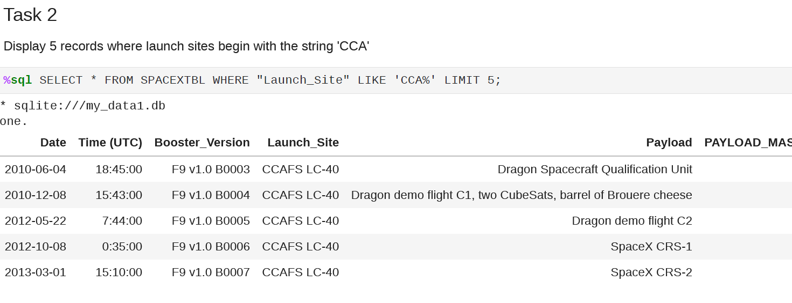
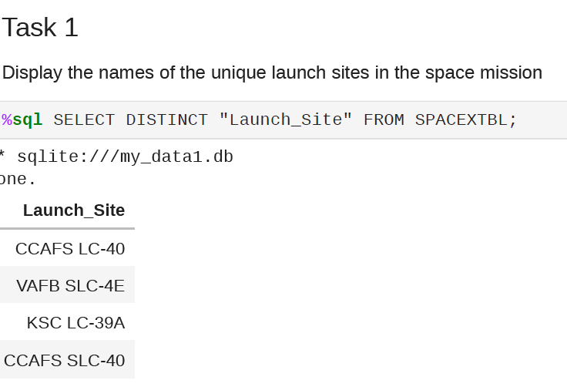
EDA and SQL Results

Slide 12
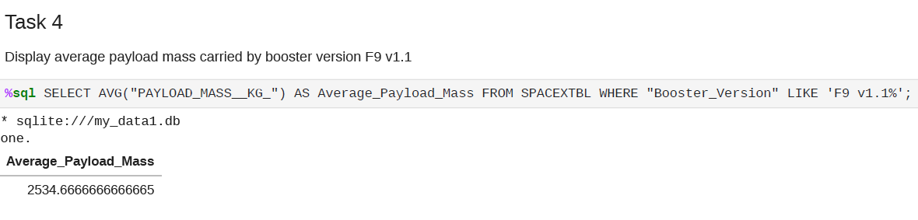
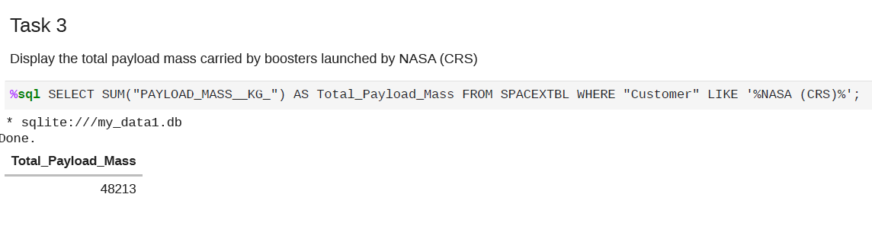
EDA and SQL Results

Slide 13
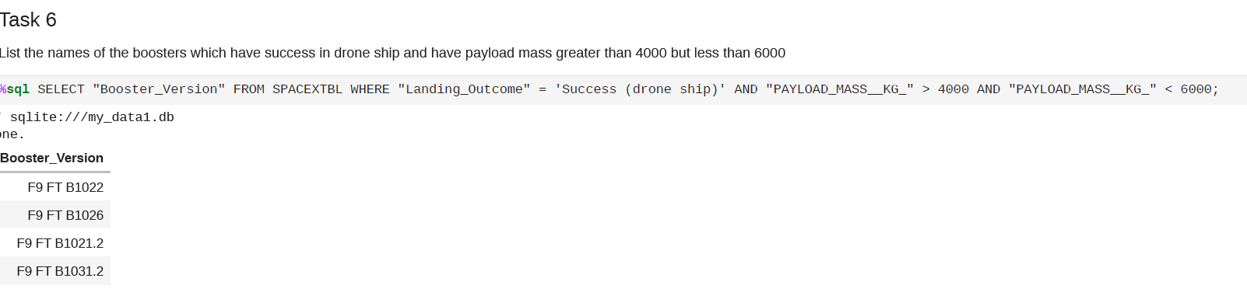
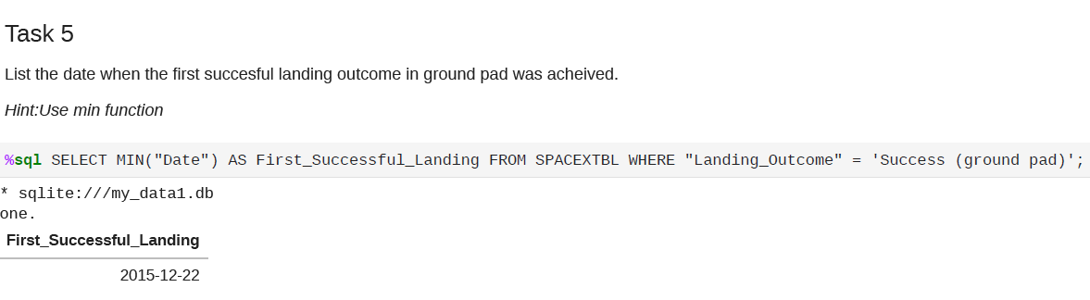
EDA and SQL Results

Slide 14
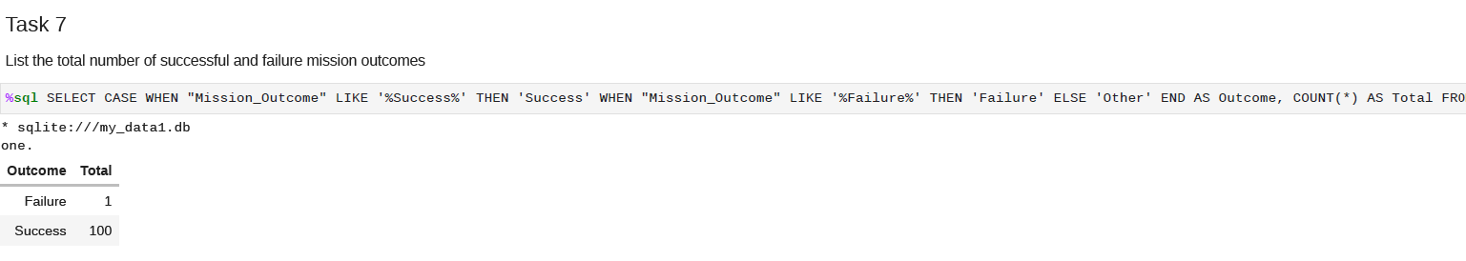
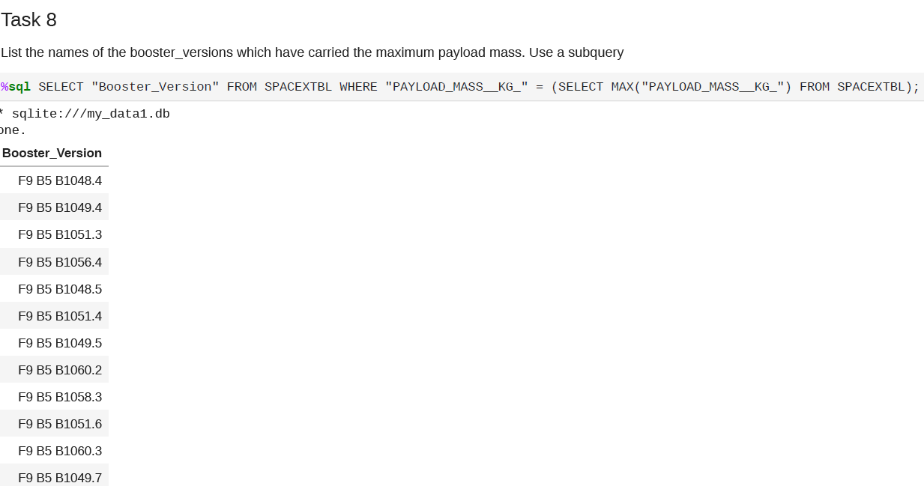
EDA and SQL Results

Slide 15
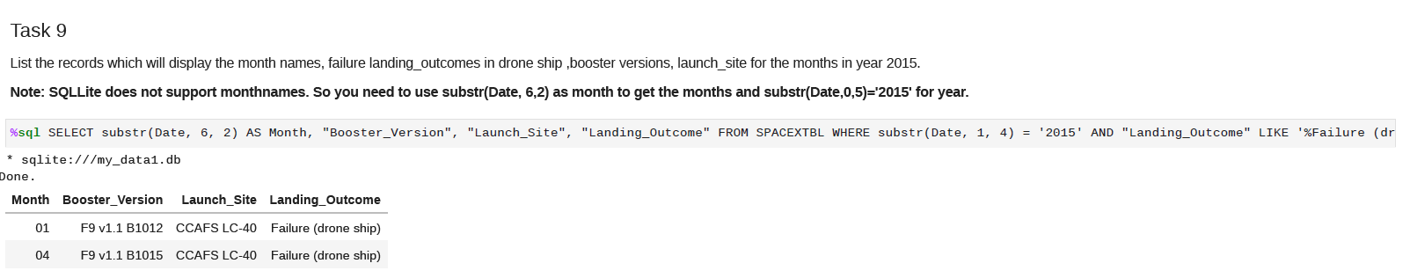
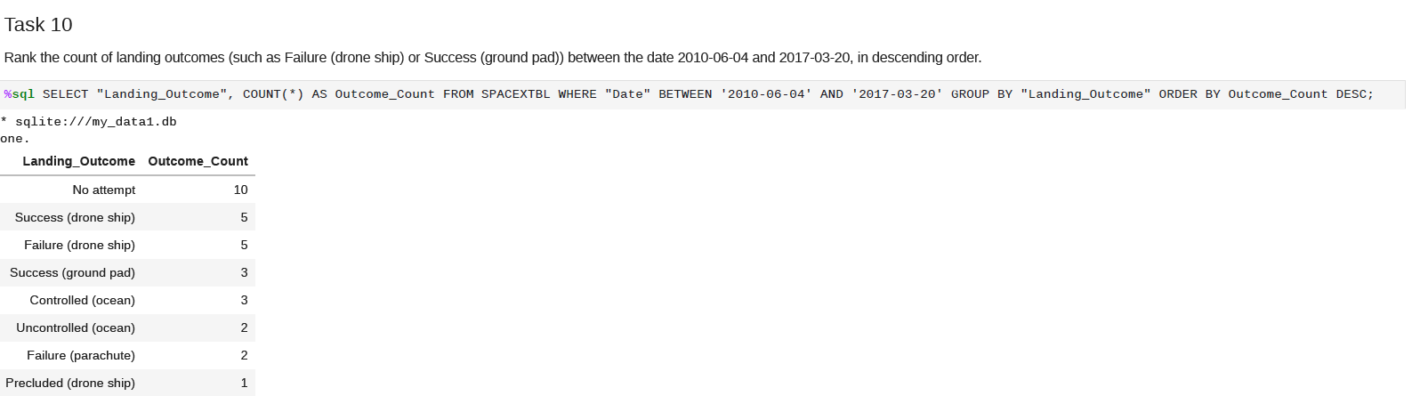
EDA and SQL Results

Slide 16
EDA WITH VISUALIZATION RESULTS

Slide 17
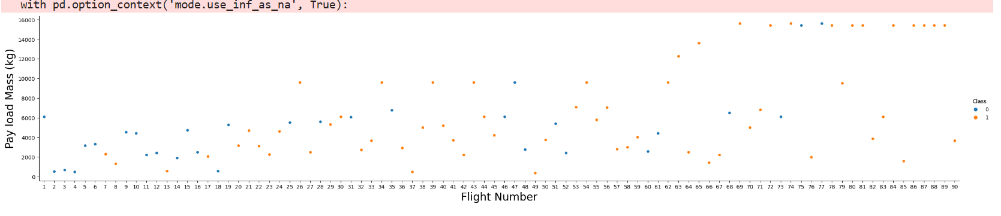
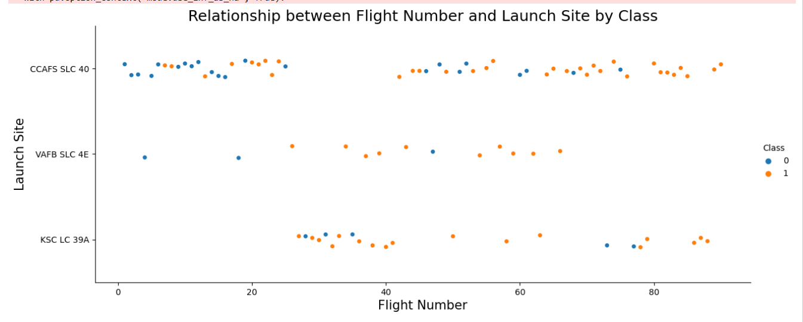

Slide 18
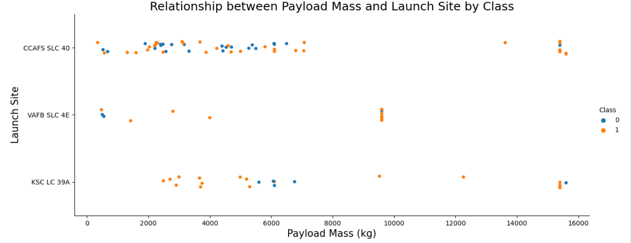

Slide 19
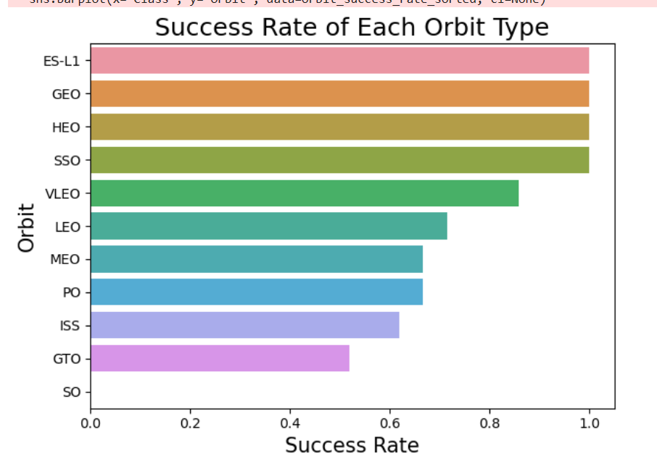

Slide 20
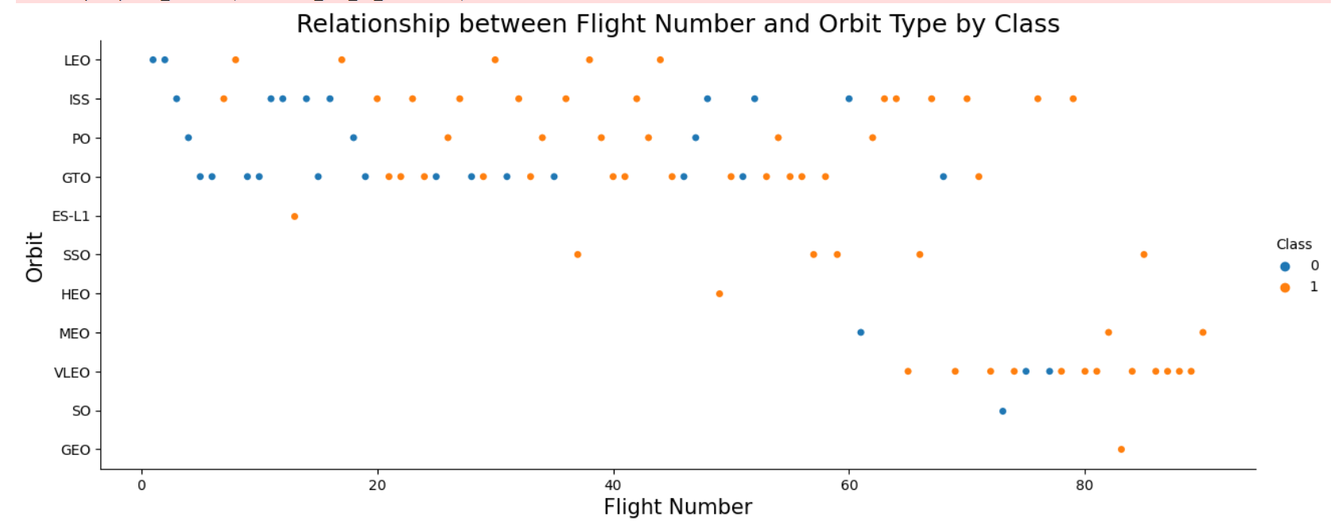

Slide 21
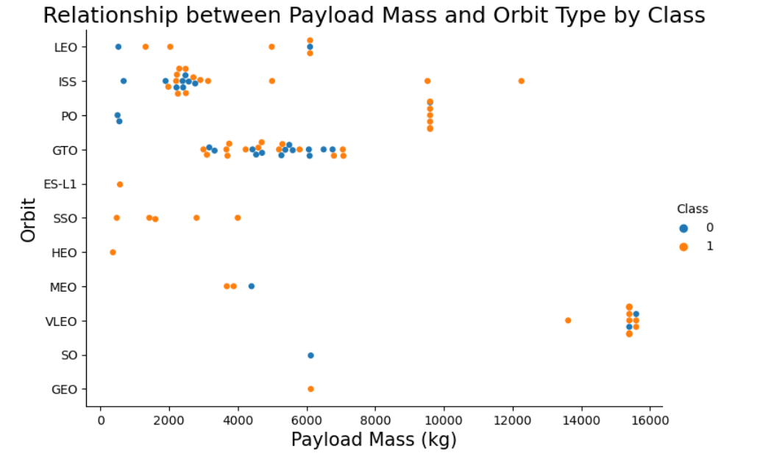

Slide 22
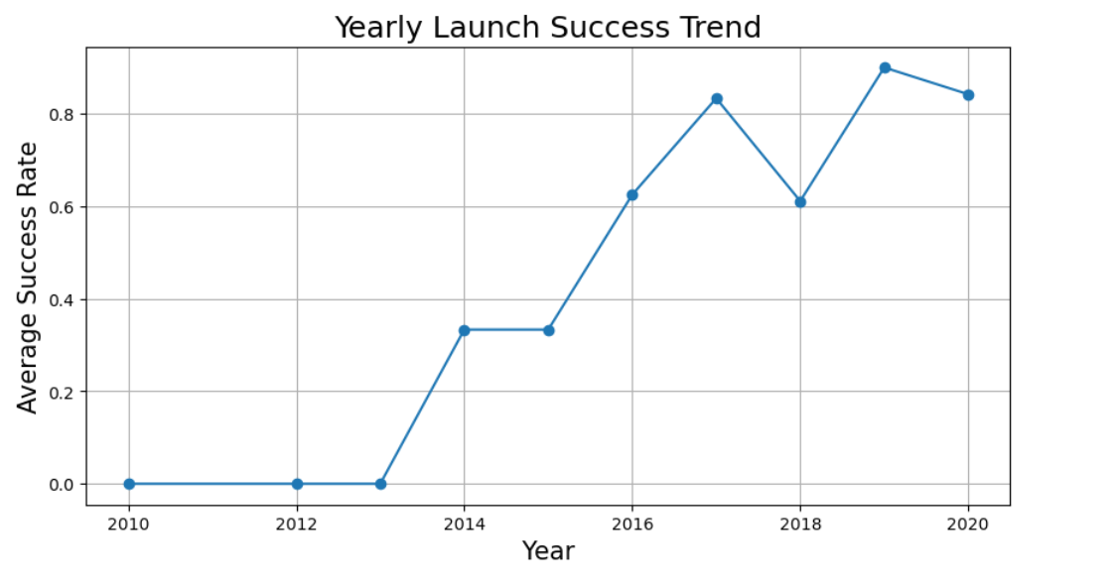

Slide 23
INTERACTIVE MAPS WITH FOLIUM

Slide 24
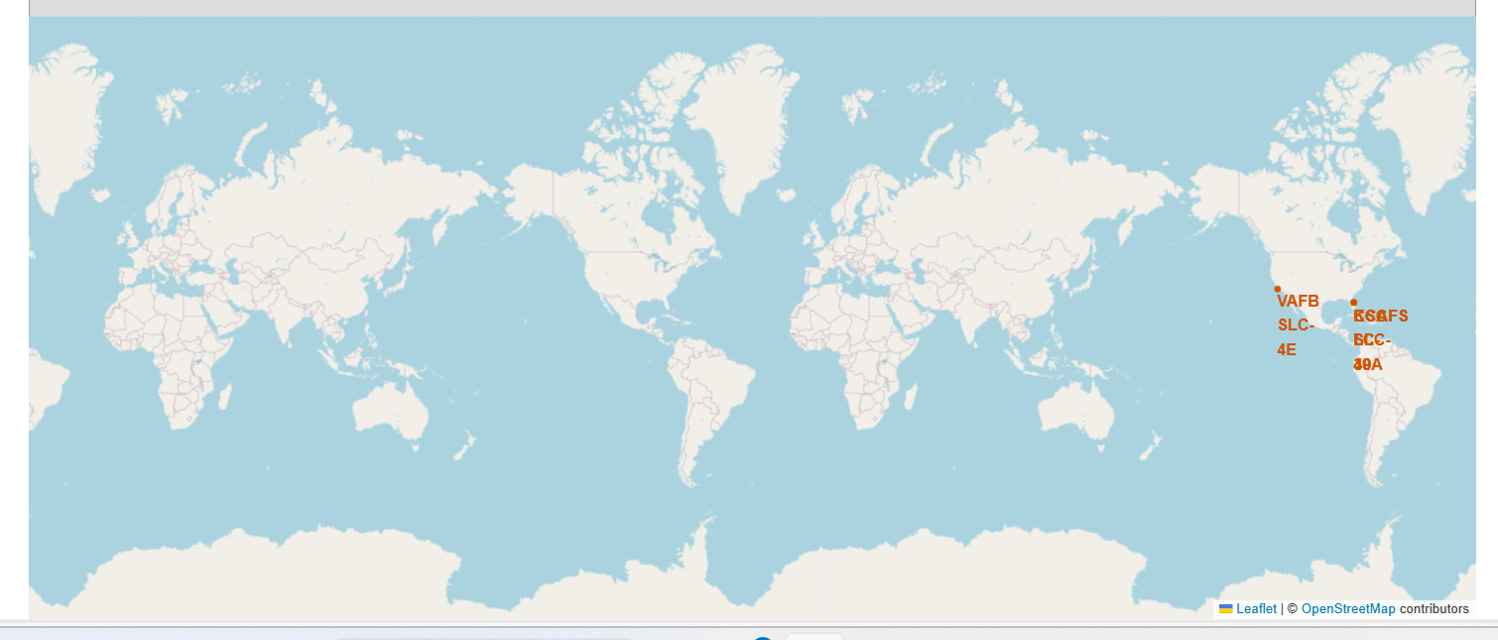

Slide 25
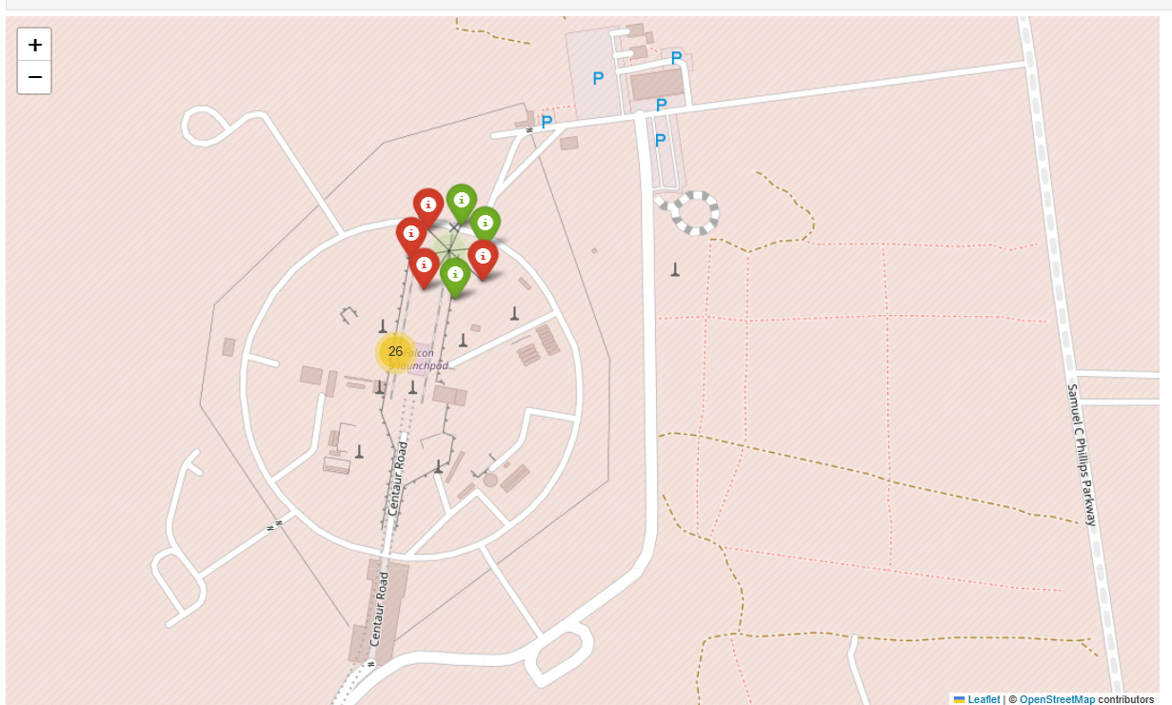

Slide 26
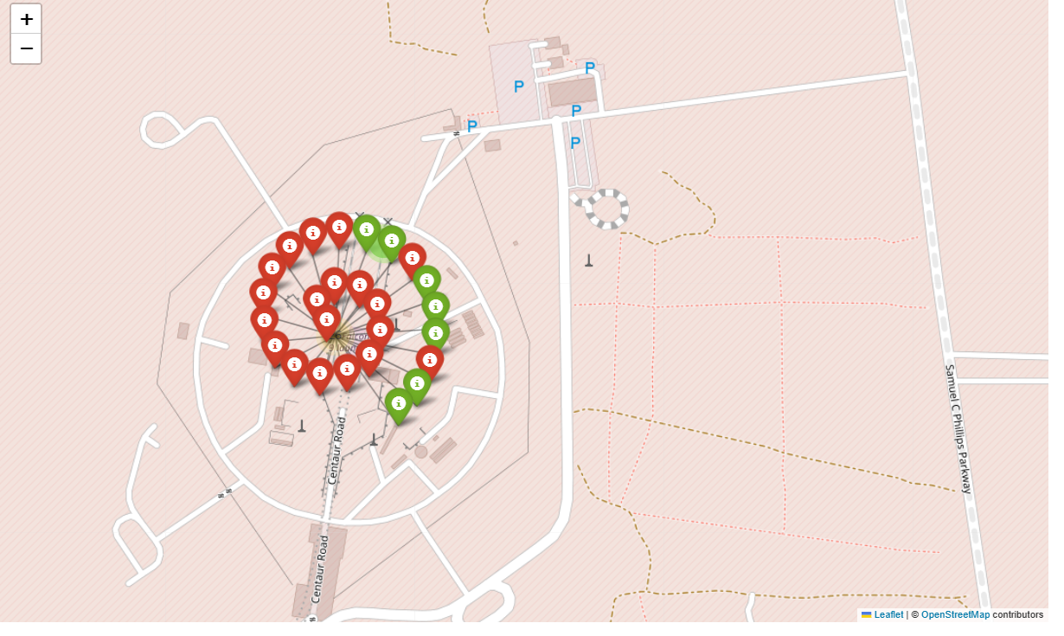

Slide 27
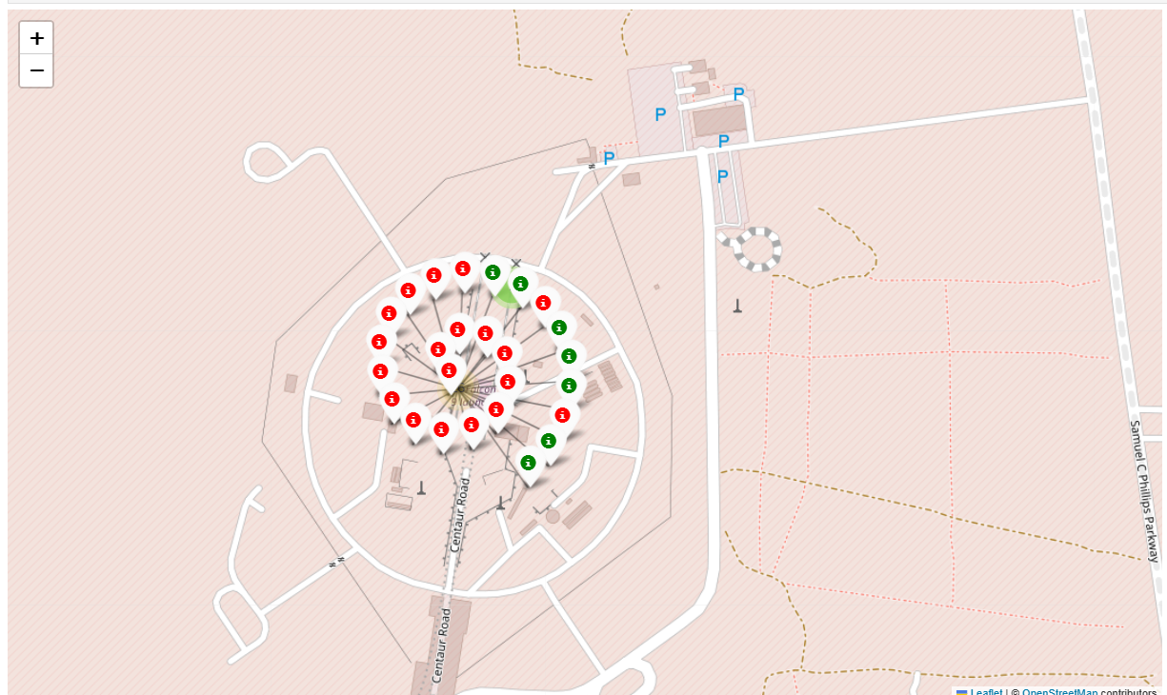

Slide 28
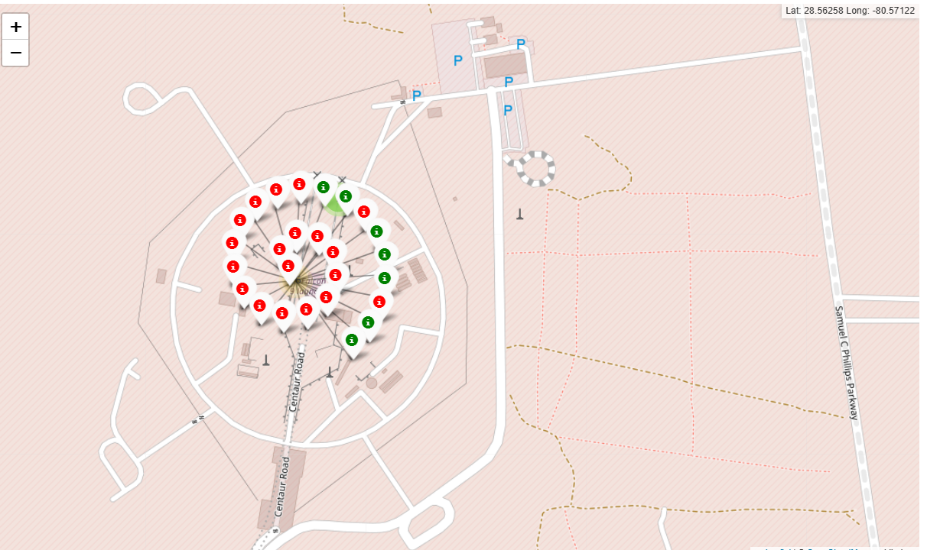

Slide 29
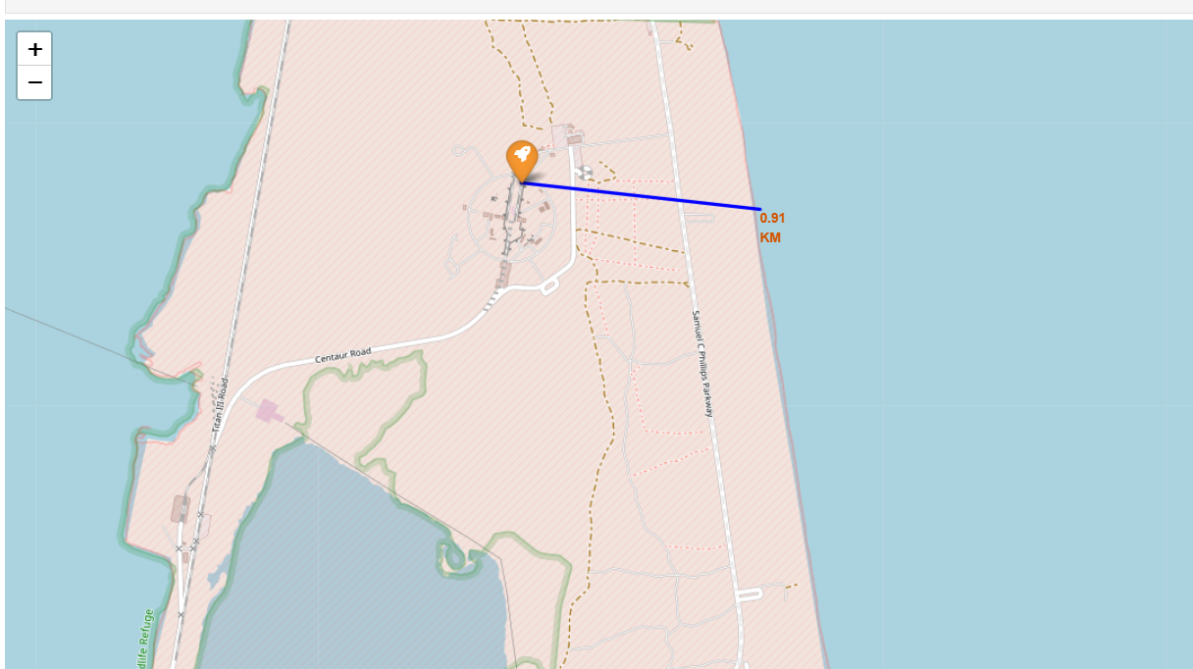

Slide 30
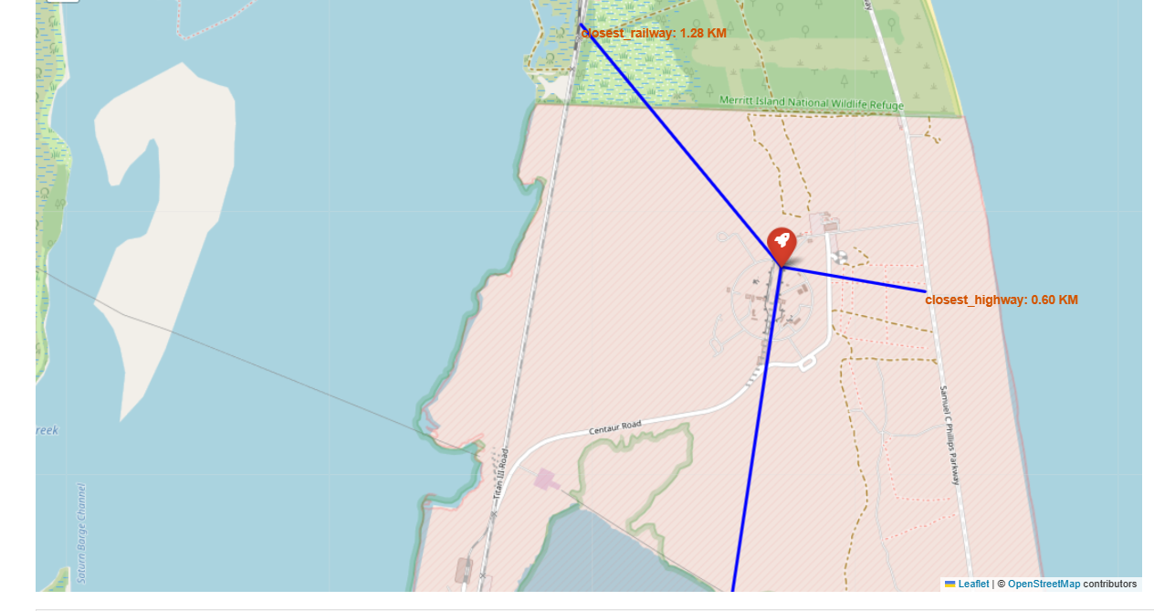

Slide 31
PLOTLY DASH-BOARD

Slide 32
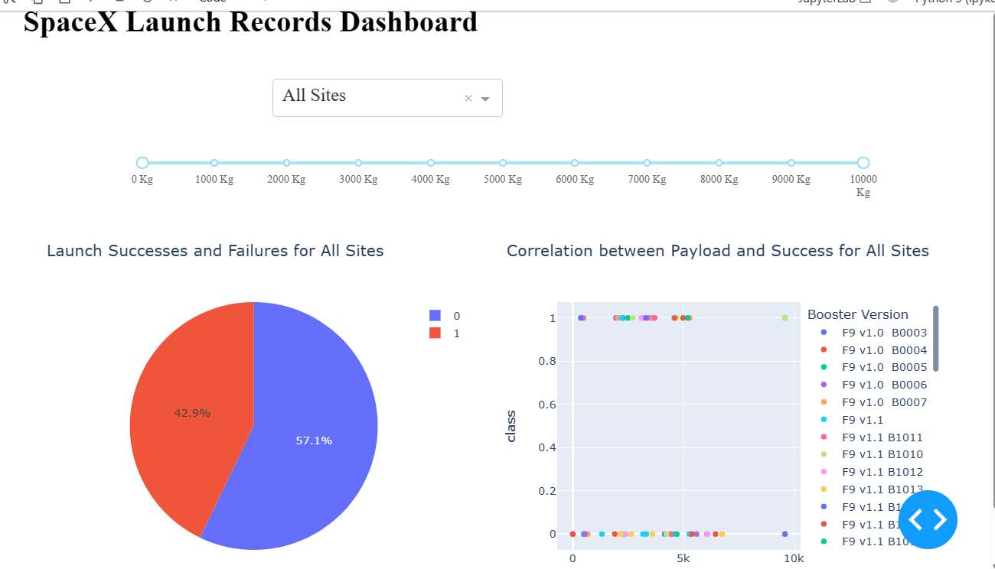

Slide 33
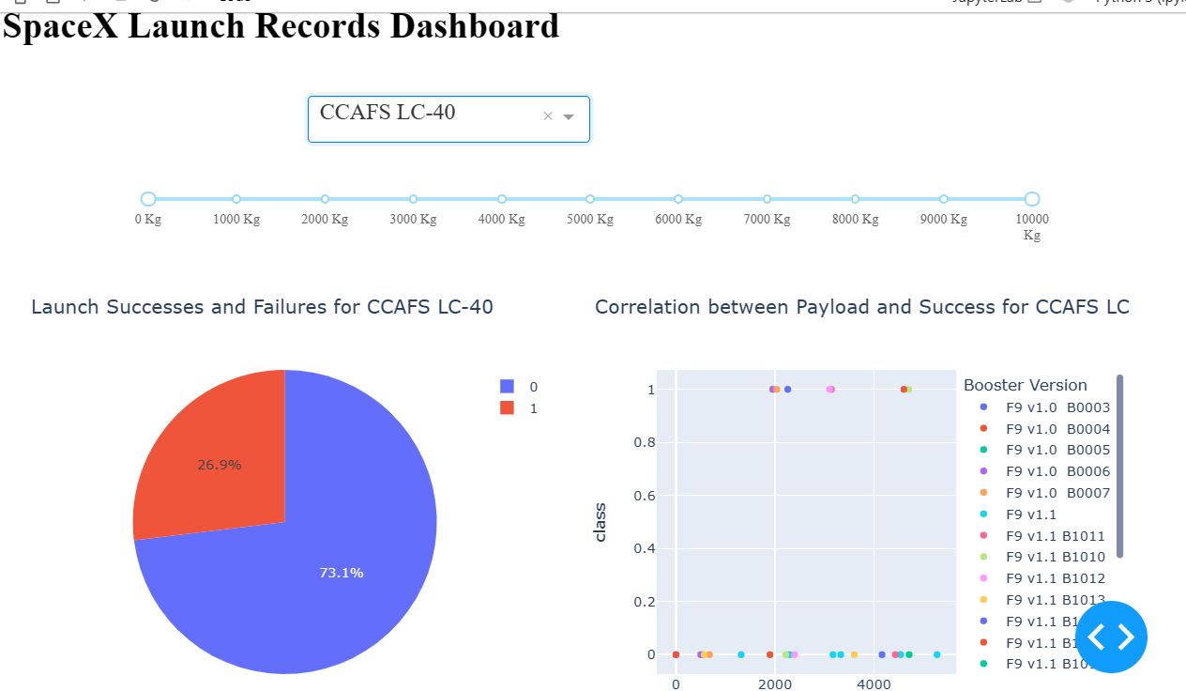

Slide 34
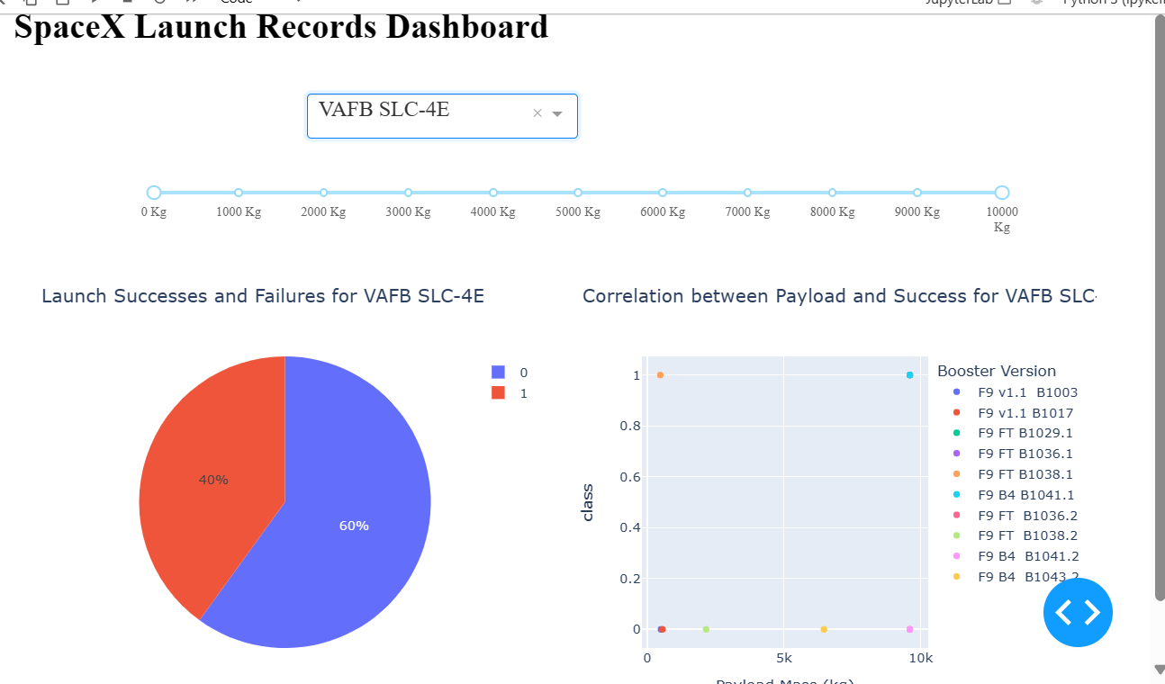

Slide 35
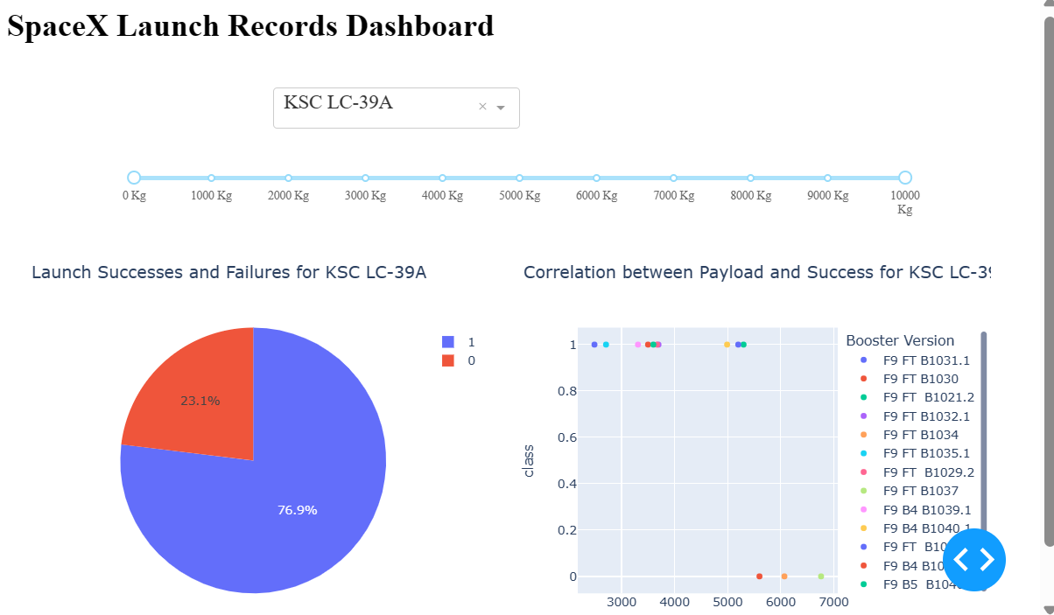

Slide 36
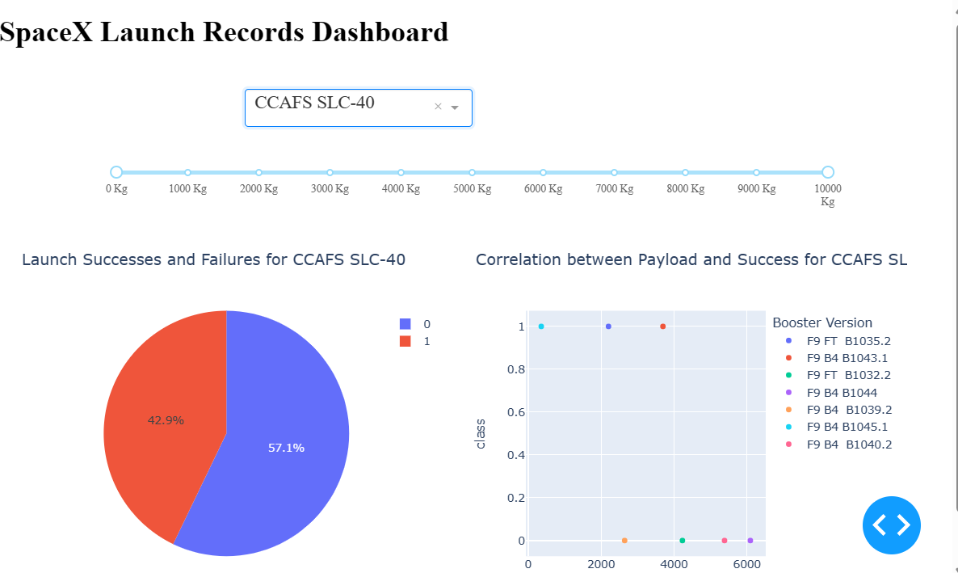

Slide 37
PREDICTIVE ANALYSIS RESULTS

Slide 38
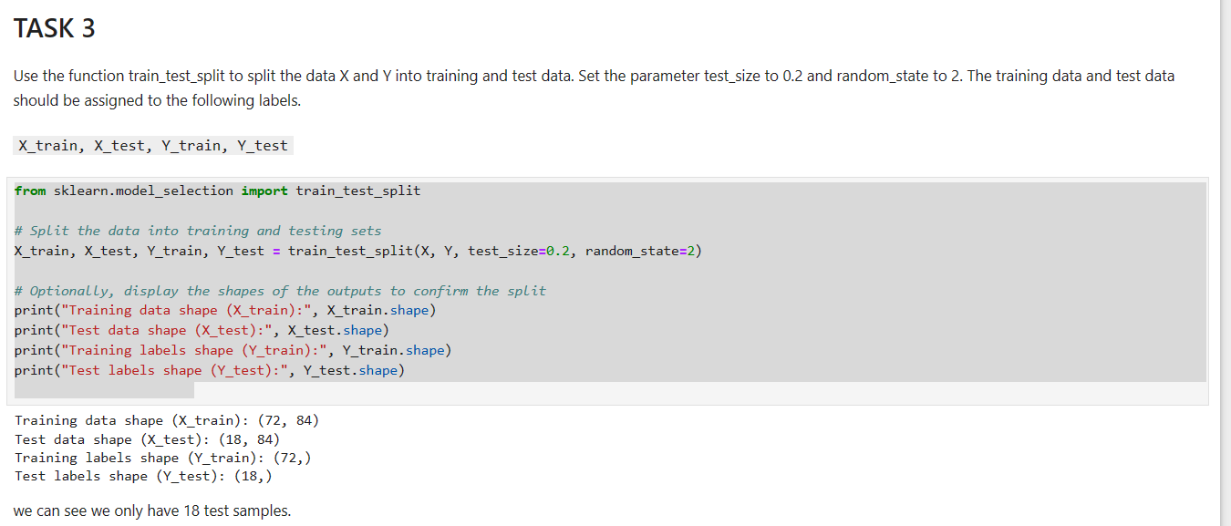

Slide 39
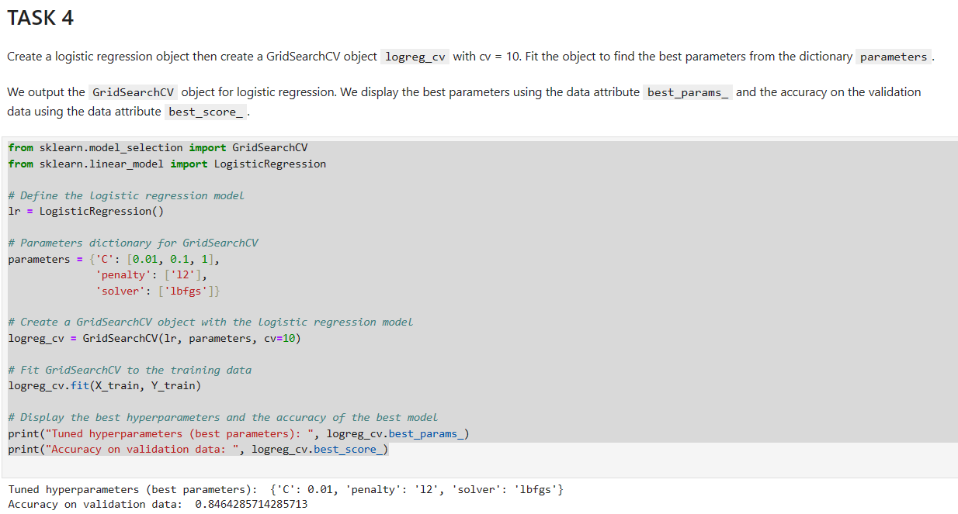

Slide 40
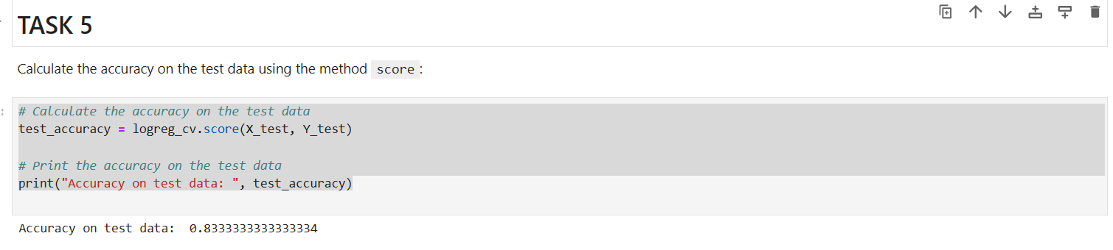

Slide 41
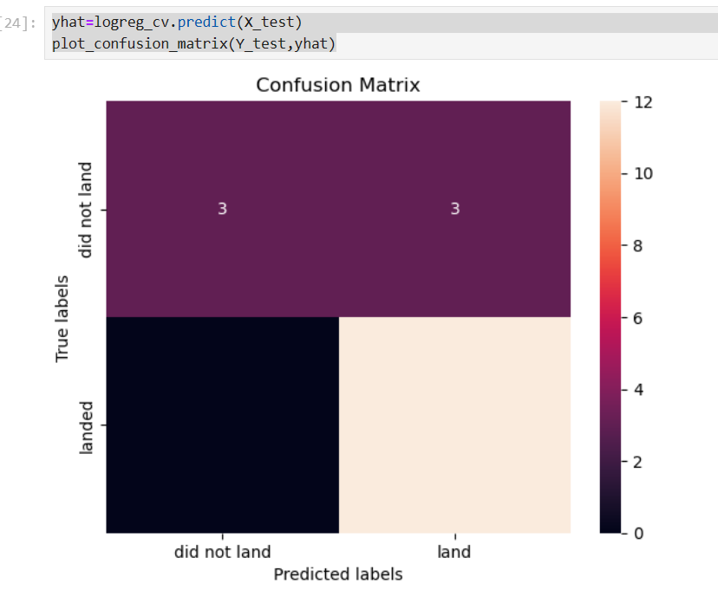

Slide 42
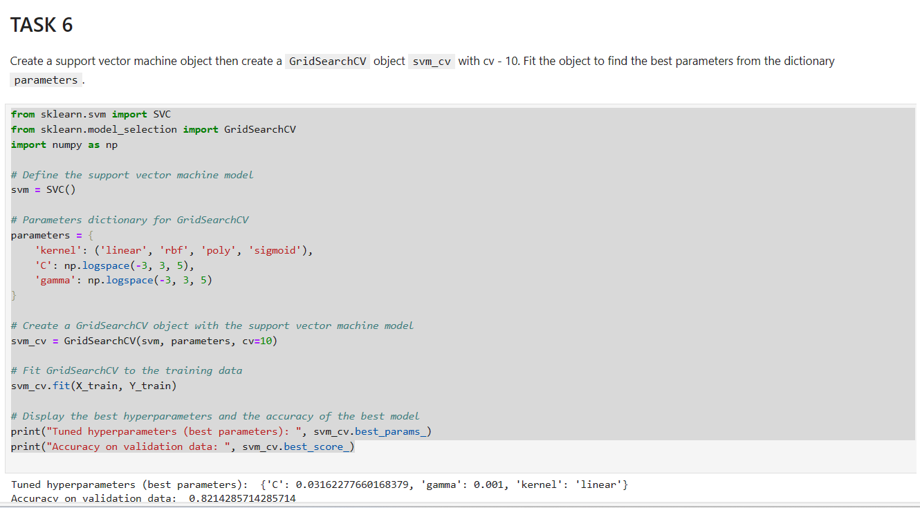

Slide 43
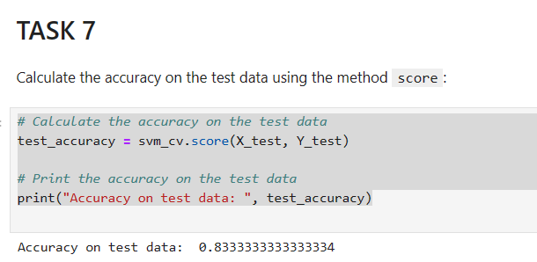

Slide 44
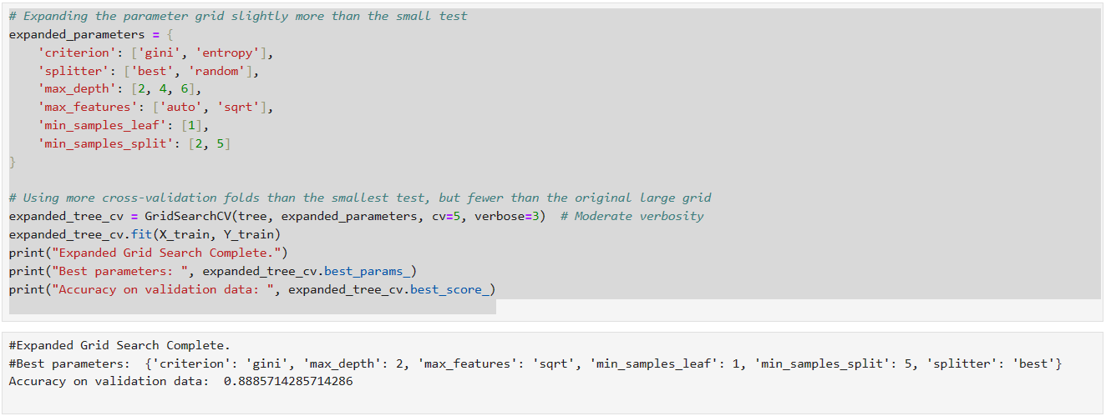

Slide 45
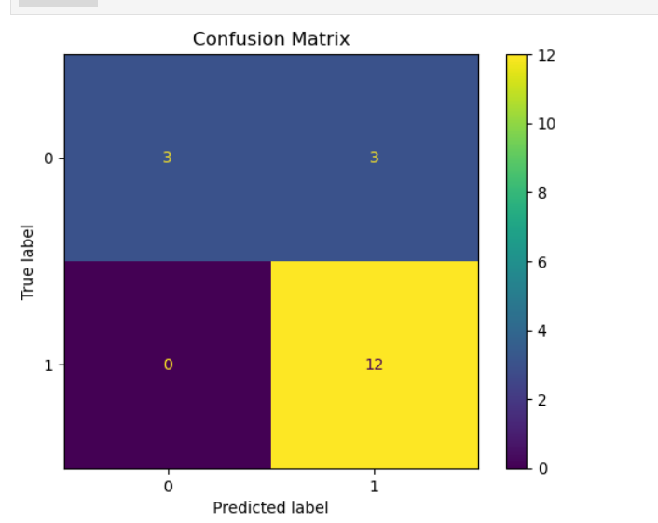

Slide 46
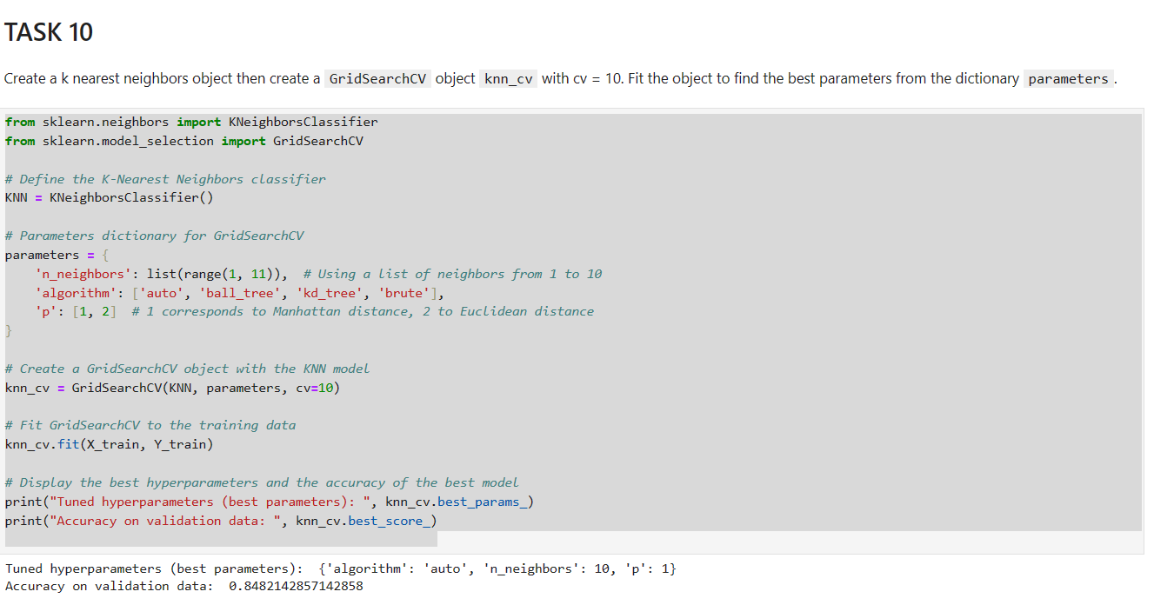

Slide 47
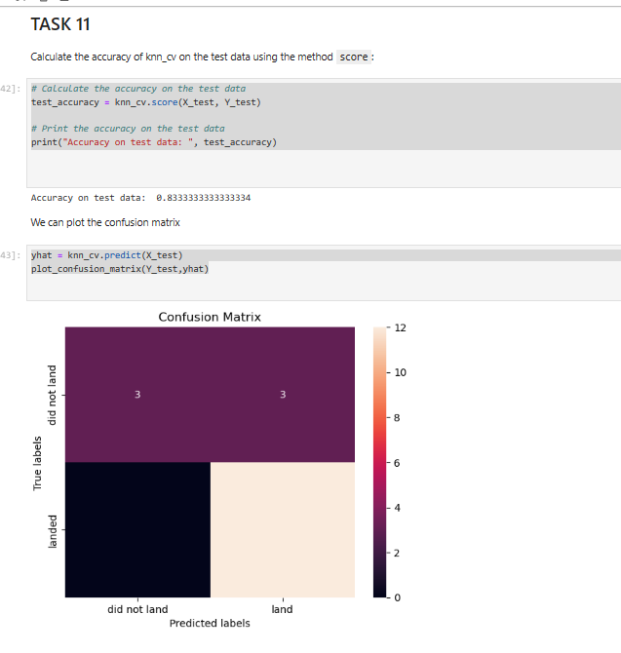

Slide 48
Launch Site Variation: Different launch sites have varying success rates; some sites show a notably higher likelihood of successful landings. Payload Influence: Heavier payloads have been associated with successful outcomes, particularly at specific launch sites, suggesting a potential relationship between payload mass and successful landings. Technological Progress: There is a clear trend showing an overall improvement in launch success rates over the years, indicating advancements in technology and operational experience. Orbit Type Success Rates: Certain orbit types have a higher success rate; this may reflect the complexity of reaching different orbits, or it might indicate more focus and expertise on certain mission profiles. Flight Number Trends: As the flight number increases, which correlates with more experience and technological refinements, there appears to be a higher success rate in landings, highlighting the benefits of iterative learning and process improvements.
Conclusion – Exploratory Data Analysis(EDA)

Slide 49
Strategic Launch Site Locations: The launch sites are strategically placed near coastlines. This proximity to vast ocean areas is likely for safety, as it provides a clear flight path over unpopulated areas, minimizing risk in case of launch failures. Infrastructure Accessibility: The maps show that launch sites are carefully situated with convenient access to critical infrastructure. Roads and railways are within close proximity, facilitating the transport of rocket components and supporting logistics efficiently, which is essential for launch preparations and operations.
Conclusion – Interactive Folium Maps

Slide 50
Launch Outcomes by Site: There is a variation in success rates across different launch sites, with some sites demonstrating a higher proportion of successful launches than others, which may suggest site-specific operational efficiencies or challenges. Payload and Success Correlation: The scatter plots show no clear correlation between the payload mass and launch success, which suggests that SpaceX is capable of handling a wide range of payload masses with a consistent success rate, pointing towards the versatility and reliability of the launch vehicles.
Conclusion – Plotly Dash-Boards

Slide 51
Model Accuracy: The accuracy scores from different models are consistently above 80%, indicating a strong predictive capability for the test data. This suggests that the features selected for the model have a significant influence on the prediction of rocket landing successes or failures. Consistency Across Models: Several models, including logistic regression, support vector machines, and k-nearest neighbors, yield similar accuracy scores, which suggests that the dataset is well-behaved, and the patterns are detectable by various algorithmic approaches. Confusion Matrix Interpretation: The confusion matrices indicate a higher number of true positives and true negatives, which shows that the models are generally successful at predicting both successful and unsuccessful landings. However, the presence of false positives and false negatives indicates there is still room for model improvement. Hyperparameter Optimization: The usage of GridSearchCV for hyperparameter tuning is effective in finding the optimal parameters for the models, which is evidenced by the improved accuracy scores upon tuning compared to default parameter settings. This demonstrates the importance of hyperparameter optimization in model performance.
Conclusion – Predictive Analysis

Slide 52
Crafting a presentation with dynamic slide layouts and engaging backgrounds turns data into a visual narrative. Simple, clear bullet points and well-organized content ensure the information is digestible, making complex topics accessible. This creative approach not only captivates the audience but also enhances comprehension and retention of the material.
Creativity Applied in Presentation

Slide 53
1. innovative and interesting insight from visualization of data as a part of EDA is the improvement in launch success rates over time, which suggests a learning curve effect at play. As the number of flights increases, the success rate also goes up, indicating that experience and technological advancements lead to better mission outcomes. This underscores the iterative nature of engineering in space travel where each launch provides valuable data to refine and enhance future missions. 2. An innovative and interesting insight from the predictive analysis is the effectiveness of the hyperparameter tuning process in improving model performance. Despite the different algorithms used, the GridSearchCV technique consistently found the best parameters that enhanced the accuracy of each model. This highlights the potential for automated machine learning (AutoML) tools to significantly streamline and optimize the model-building process, leading to robust predictive performance with less manual intervention.
Innovative Insights from the Data Analysis

Slide 54

Thank you

